Slide 1
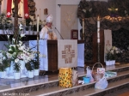
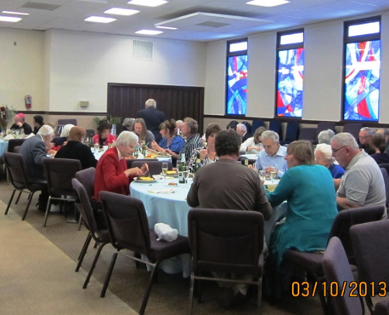
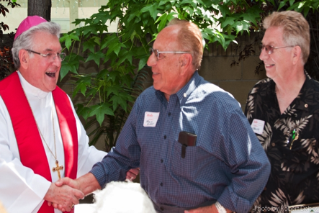
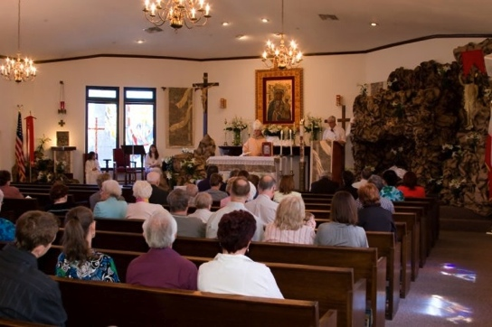
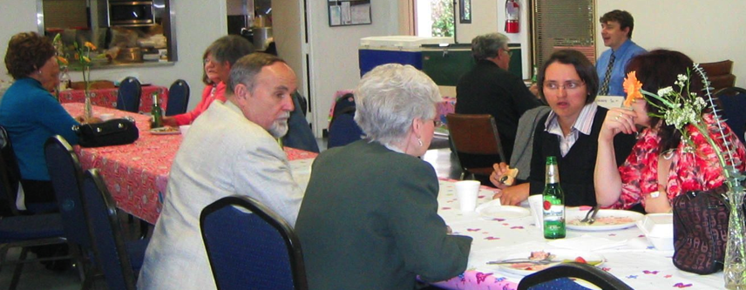
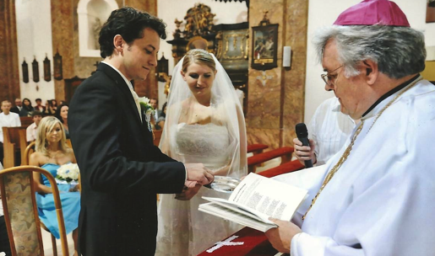
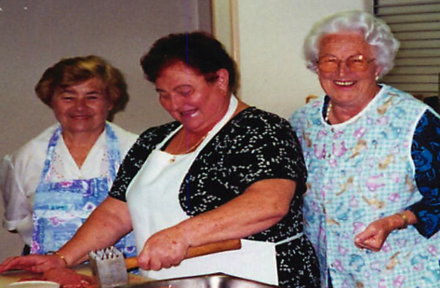
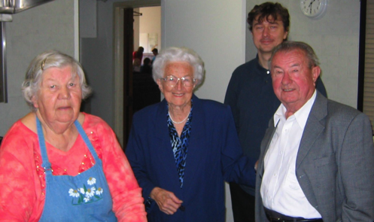
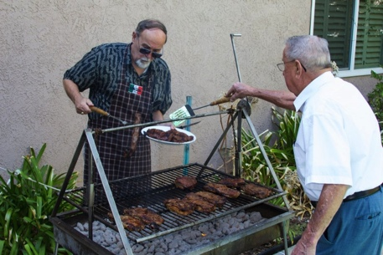
CONGRATULATIONS !
50 YEAR ANNIVERSARY
This year the Czech/Slovak Catholic mission in California is celebrating it’s 50th anniversary. As a member of our community and heritage we hope that you would like to participate in our Commemorative Book by submitting any:
Family announcements
Greetings and congratulations
Memorials for deceased family members
Business announcements
Funds in becoming a sponsor of this project.
Please send your commemorative inputs for inclusion with your check to Mr. Frank Onderka at the address below. The deadline is July 15, 2014.
Frank Onderka
(310-768-1836)
(Home: 310-532-1829)
1128 W. Gardena Blvd
Gardena, CA, 90247
Email: Frankgvlion@aol.com
For additional info or help:
GeorgeDvorskydngdvorsky@verizon.net, 310-545-9302
JudyBroberg SleuthJB@pacbell.net 714-528-4725
Frank Blazek mblazek4121@sbcglobal.net
Prices range from full page in color ($500) to quarter page in black & white ($40). See commemorative letter for price schedule. (Make checks payable to the Czech Mission)

Slide 2
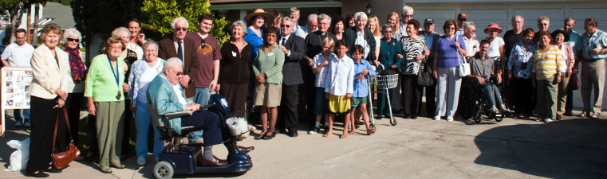
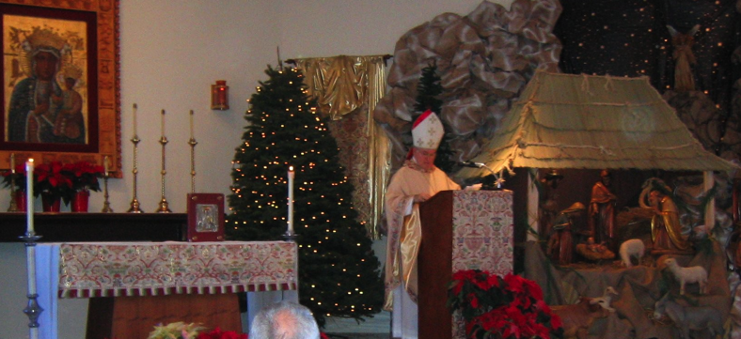
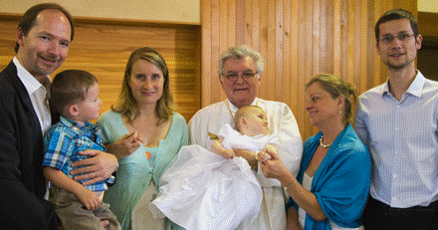
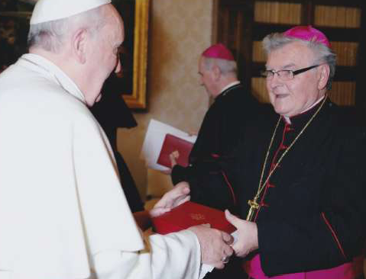
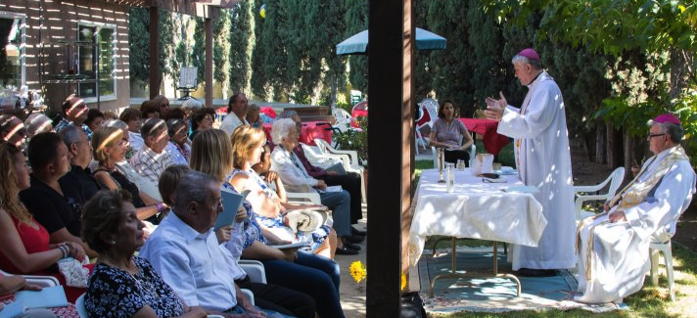
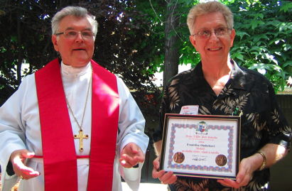
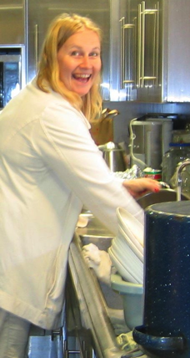
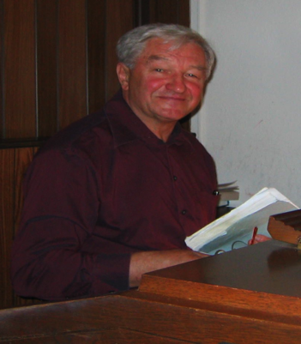
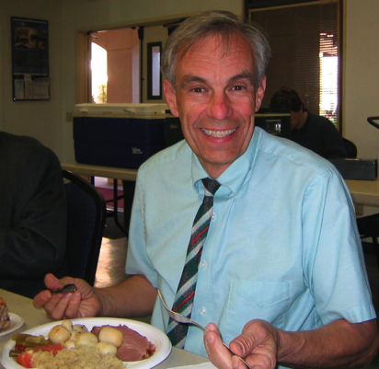
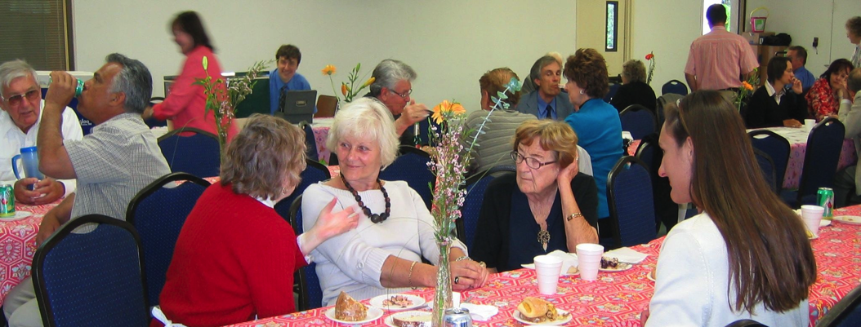
Please share your memorable events, Remembering loved ones and Family members who were part of our Czech/Slovak fellowship.
These snips of photos are just to stimulate our memories of good times and blessings from God for our heritage.
Notes:
Please share your memorable events

